Slide 1



LinkedIn Optimization
How to make your LinkedIn Proﬁle the best it can be!

Slide 2
Why LinkedIn?
Companies maintain up-to-date proﬁles for
candidates to research and connect with employees
Hiring Managers look at your LinkedIn (even if you applied via another method)
You can cultivate and maintain meaningful connections with your growing network
58 million
Companies listed on LinkedIn
15 million
Open jobs are posted on LinkedIn
36,000
Skills can be added to your proﬁle

Slide 3

85%
of jobs are ﬁlled through networking
70%
of jobs are never published publicly
#1
way companies recruit is through employee referrals

Slide 4



What we are working on
Optimize Your Proﬁle
Write engaging headlines and summaries while including keywords relevant to your interests
Connect
Engage with a broader network for informational interviewing
If you work hard on your job, you make a living.
If you work hard on yourself, you make a fortune.
-Jim Rohn Entrepreneur and Motivational Speaker
Search
Research and Identify internships and full time employment opportunities

Slide 5

Be who you are and
Be that well
—St. Francis de Sales

Slide 6
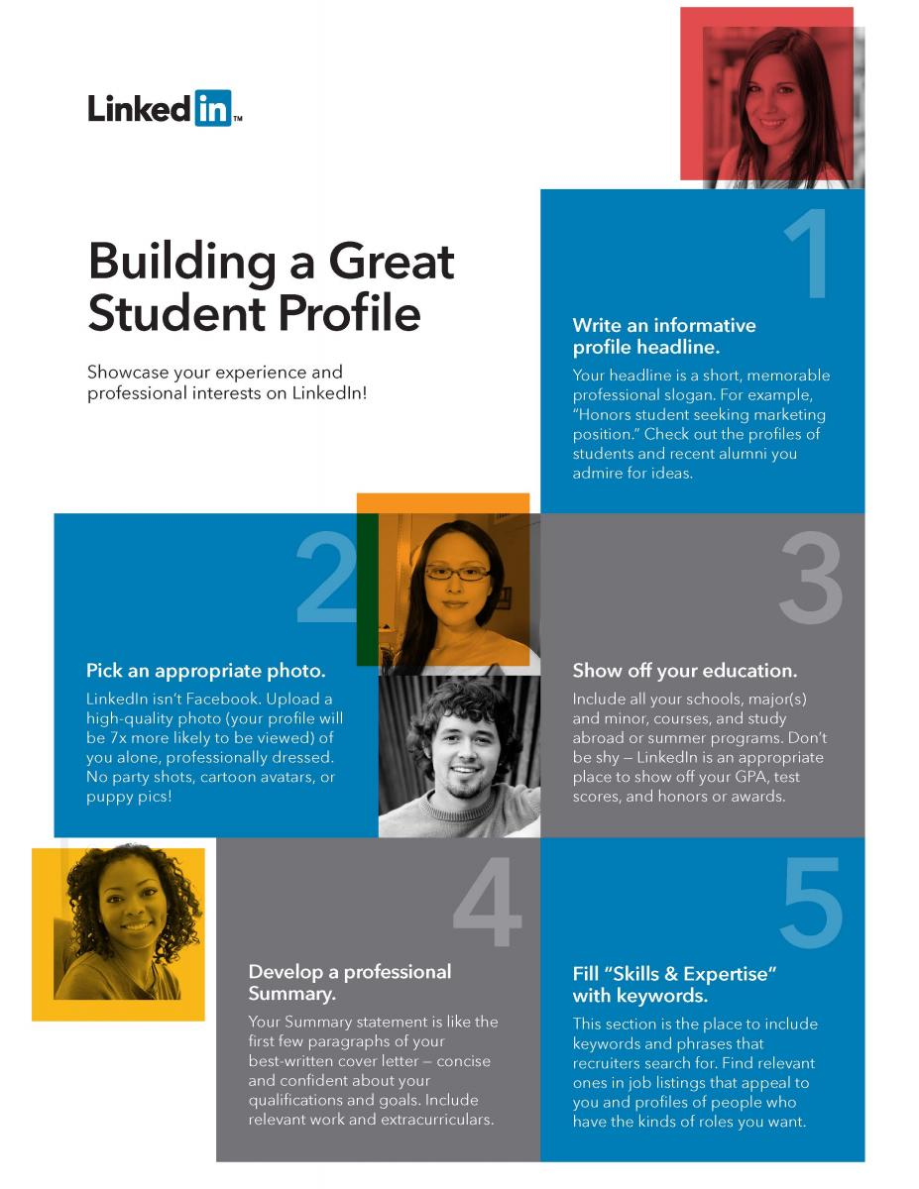
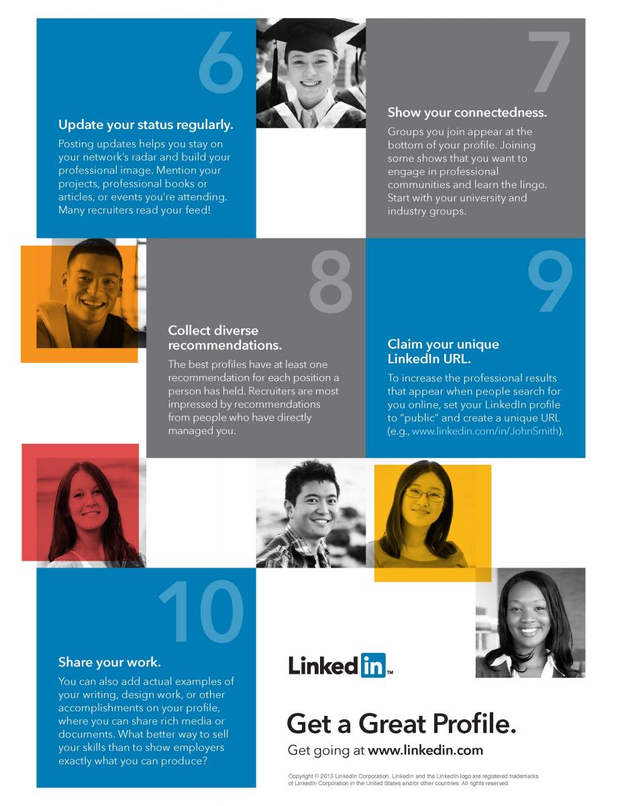

Slide 7

Headlines
What do you aspire to be?
How do you solve problems?
What are your strengths?
What is your immediate career goal? What do you study or plan to study?

Slide 8

Examples
Working Professional
Financial Analyst | Providing Insights for Data Driven Decisions
High Schooler
Gadget Lover | Aspiring Engineer Seeking Summer Internship | Interest in Data Analysis & Computer
Science
Undergraduate or Graduate Student
Marketing Intern at American Red Cross | Social Media Content
Creator | Data and Analysis
Aspiring Project Manager | Master of Science in Business |
Experienced in Scrum and Agile
Combining Psychology and Business Education to Serve Marginalized Communities | Critical Thinker and Solutions-Oriented

Slide 9
Workshop
Update Privacy Settings
Edit Proﬁle
Update Headline:
What do you aspire to be?

Slide 10

Professional Summary: What do I say?
Who You Are
What You Do and What You Did
What You Want and WHY

Slide 11

Professional Summary:
How do I say it? 6 Tips
3. Frame your Past
Connect the dots of your prior experiences. Highlight your successes that mean the most to you and your future goals
1. Describe what makes you tick
Passion is the heart of some of
the best summaries (About) sections. Opening up about what you love to do adds context to your career.
What excites you most professionally?
What drives you besides a paycheck?
2. Explain your present role
Put your job title aside and describe what you do in simplest terms.
What problems you solve? for whom? and how?
This is a great way to demonstrate your skills, industry knowledge, and/or work style

Slide 12
Professional Summary:
How do I say it? 6 Tips
6. Utilize keywords
Add “Specialities:” at the end of your summary to help improve your search rank on LinkedIn and Google.
Find keywords in job descriptions and other relevant proﬁles.
Incorporate keywords naturally into your story as much as possible!
4. Reveal your Character
Great summaries hit traits like
gratitude, humility, and humor.
Authenticity is key- choose stories and words that show who you are as a person
Write how you speak!
No special characters or emojis
5. Tell stories
Make your ﬁrst sentence count! “When I was 11 years old..” or “My former boss sat me down one day..” to reveal why you love what you love

Slide 13

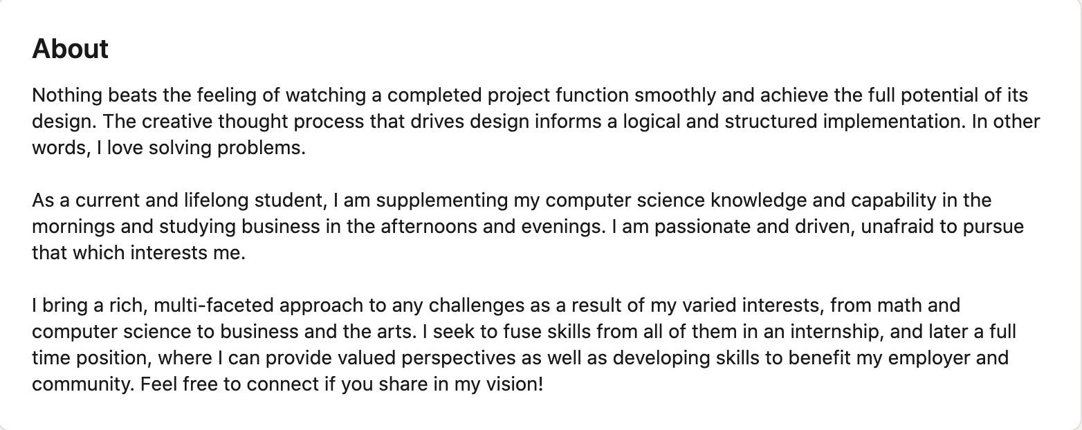
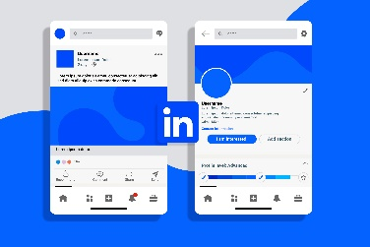
Examples

Slide 14
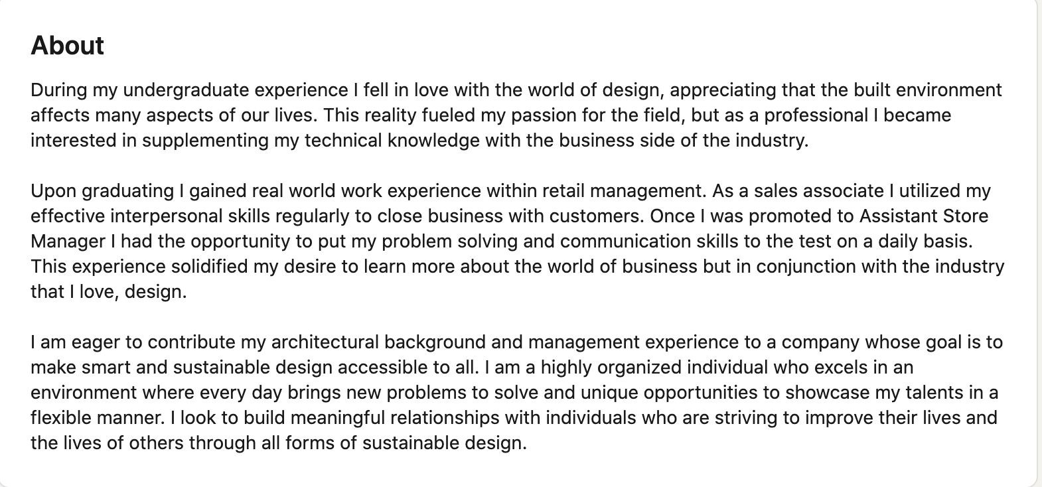

Examples

Slide 15

How do I ﬁnd the right keywords to add to my proﬁle?

Slide 16
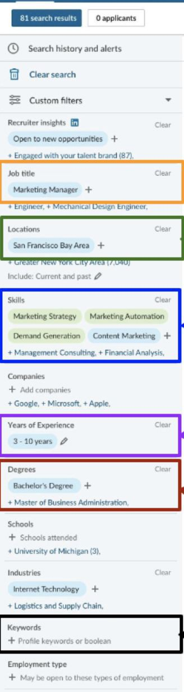
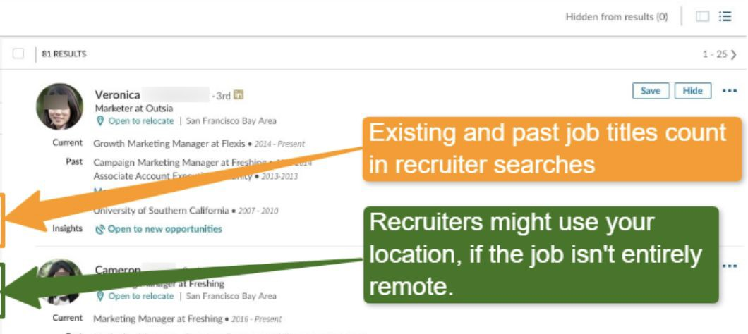
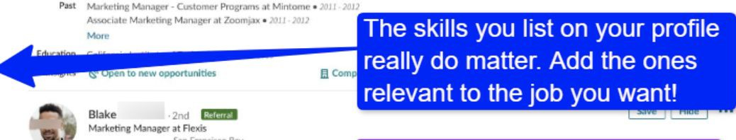
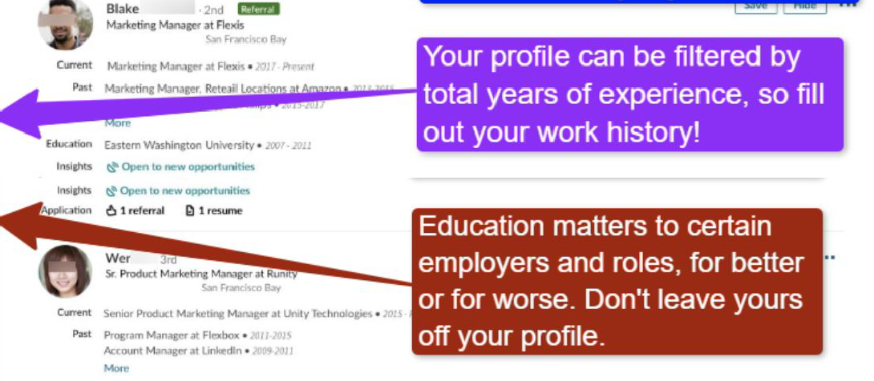
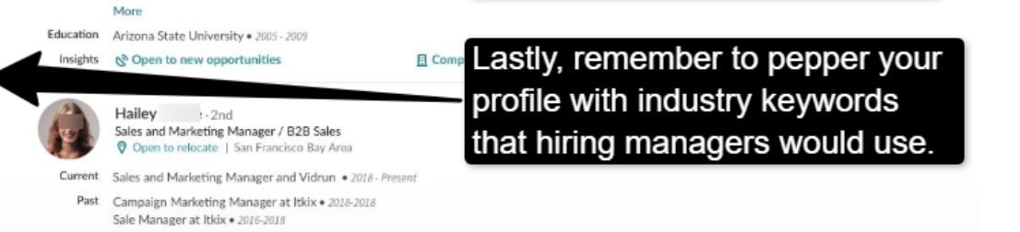
Recruiter’s View
on LinkedIn

Slide 17


How do I ﬁnd the right keywords in
Job Descriptions
1 2
3
Include Transferable Skills
Identify the most common words used
These are your keywords!
You can use free software platforms like Word Clouds to help extract common words
Focus on
Requirements and Responsibilities
Top transferable skills according
to LinkedIn:
creativity critical thinking communication leadership researching teamwork technical skills

Slide 18
Example
Key Responsibilities
World Vision Internships provide a three-month opportunity for exceptional students and recent Internship Description graduates ready to explore a career in the international relief and development sector.
As an intern, you will assist us in creating content and updating our external-facing website and internal intranet, which are both utilized to build thought leadership and communicate program impact on health and nutrition. In addition, you will also support our efforts to produce social media content for global days such as International Women’s Day, World Tuberculosis Day, World Health-Worker Week, World Health Day, World Immunization Week, World Malaria Day and World Breastfeeding Week to showcase the work that World Vision is doing in these areas.
Develop your communication, content creation, editing and story-telling skills for web and social media platforms. In addition, you will have access to weekly professional development programming delivered by WV People and Culture, as well as regular interaction with WV’s health and nutrition experts
Develop and update website content on prioritized program areas on World Vision's external facing website (wvi.org) to
grow WVI’s online presence and build our technical brand
Create content on World Vision's Sharepoint intranet platform following a recent platform migration.
Produce social media content for Global Days related to health and nutrition to communicate program results and build awareness of WV's program portfolio
Potential work on conference/external engagement side events or sessions.

Slide 19

Most Common Words/ Phrases KEYWORDS
Create Content/ Content Creation
Produce Social Media
Update Website
Communication Skills
Editing Skills
Storytelling Skills
Platforms: MonkeyLearn.com | Freewordcloudgenerator.com

Slide 20
QUESTIONS?

Slide 21

Thank You
Follow
The Catholic University of America and
The Center for Academic & Career Success on Social Media and at catholic.edu
CREDITS: This presentation template was created by Slidesgo, and includes icons by Flaticon and infographics & images by Freepik

